Slide 1


Introduction to
Game Day
Philosophy and Purpose
Format
Skill Restrictions
Score Sheet Breakdown

Slide 2

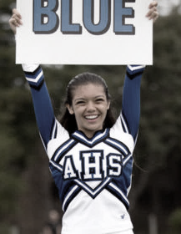
What Is Game Day?
Game Day is a competition that rewards traditional cheerleading responsibilities at the schools
It gives teams a forum to compete in categories that reflect what they do on the sidelines to engage crowd involvement and demonstrate school traditions
Categories
  Band Dance, Situational Sideline/Time-Out Cheer, Fight Song
Notes:
Sarah

Slide 3
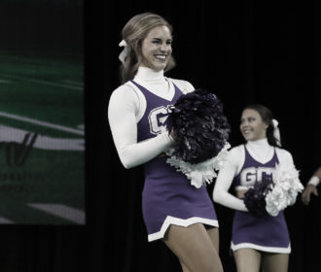
What Is Game Day?
Emphasize leadership roles in schools
  Stay true to mission and vision
  Traditional sideline roles in schools
Create opportunities, not limitations
  Sideline to performance floor
  Opportunity for involving multiple spirit and student groups
Keep expenses for schools minimal
  No full choreography needed
  No music mixes required
Notes:
Sarah

Slide 4
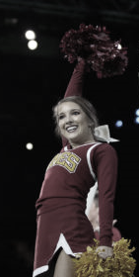
Benefits of Game Day
Program growth
  increased participation
  Score sheet structure and skill restrictions
Return to the competitive floor
  Point of entry is easier for teams
Increased positive game presence
  Teams focus on getting better on actual sideline
  Realize that doing well at games is also improving for the competition side
New ways to succeed
  Opens up “competition” to teams not use to competing
  Allows teams not use to a competition setting to be comfortable and be recognized
Notes:
Frank

Slide 5
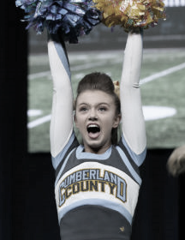
Benefits of Game Day - Safety
Reduced risk of injury
  Restriction of skills and de-emphasizes tumbling
Does not require the following
  Extensive Choreography
  Music costs (still have the copyright issues to address)
  Heavily emphasize difficulty or individual skill thus potentially limiting participation and increase risk of injury
Notes:
Frank

Slide 6
Why Now?
With recent changes to competitive parameters, this retains the components of traditional cheerleading.
The recent decline in the number of teams competing.
Decrease in the presence of cheerleading teams at high schools.
Decreased cheerleading presence at school and community events.
Notes:
Frank

Slide 7
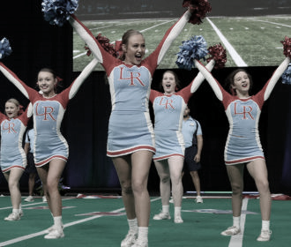

How Are Teams Judged
Teams are judged on execution, crowd effectiveness, energy, and overall performance
Deductions are still in place for Game Day and crowd-readiness and perfection is CRITICAL
Notes:
Sarah

Slide 8
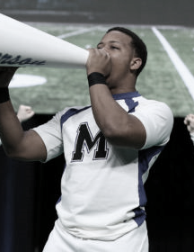
Format
Executed in this order:
  Band Chant
  Situational Sideline
  Crowd Leading Cheer
  Fight Song
**3:00 minute Total Time Limit**
Notes:
Should we address the excessive gesture rule as well? Sarah

Slide 9
Overview
Band Chant
The Band Chant will be consistent with traditional band chants used by teams on sidelines across the country. Teams should demonstrate spirit and enthusiasm while entering the performance floor and before the music begins. A cue will not be given to start the Band Chant. Once the music begins, the teams cannot incorporate any skills other than kicks and jumps, just like summer camp. Squads should utilize spirit raising props and focus on creative movements such as level changes or ripples, execution of the material and encouraging the crowd to participate.
Situational Sideline
Following the Band Chant, the announcer will provide a cue for offense or defense. Teams should wait until the announcer finishes the cue and show the proper response to the game day situation. Squads should focus on crowd effectiveness, motion technique and skills relevant to a game day environment. NOTE: It is a requirement to incorporate skills into the Sideline (stunts and/or tumbling, if the division allows). Please review skill restrictions.
Notes:
“Please review the skill restrictions below.” This should be taken out or changed to “Please review the skill restrictions referenced in later slides.”

Slide 10
Overview
Crowd Leading Cheer
Following the Sideline, teams MUST return to the performance surface and show a clear separation between elements. Teams can show spirited interaction as a clear transition into the Crowd Leading material but are not allowed to stunt. Crowd Leading can include a cheer reflective of a timeout, general sideline / spell-out or other cheer material with minimal words, inciting a response and encouraging a crowd to yell along. Teams should incorporate spirit props and practical skills (stunts and/or tumbling, if the division allows).
Fight Song
The final element should reflect your school’s traditional Fight Song. Teams should incorporate crowd effective skills (stunts and/or tumbling, if the division allows) and can include spirit raising props to enhance the overall effect. Fight Song incorporation is limited to three (3) consecutive 8-counts of stunts and/or tumbling. Counting will begin with the initiation of a skill and continue until either the incorporation is complete or the end of the 3rd 8-count. (If the Fight Song repeats, the incorporation will only be permitted both times if the skills are repeated exactly the same.) For teams that do not have an official Fight Song, it is recommended to use a second selection of band chant music.
Notes:
Frank

Slide 11
Game Day Skill Restrictions
No Tosses (basket, sponge or elevator) are allowed.
No Inversions are allowed.
No Twisting Released Dismounts are allowed.
Single leg stunts are limited to liberties and liberty hitches.
No Running Tumbling is allowed.
Standing Tumbling is limited to one tumbling skill and a back tuck is the most elite tumbling skill allowed.
Stunts are not allowed as a transition before/between sections. This includes entrance to the floor and between the Situational Sideline and the Crowd leading Cheer
Notes:
Should we address the excessive gesture rule as well? Sarah

Slide 12
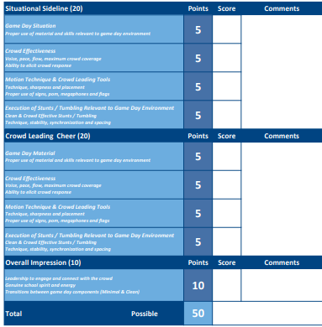
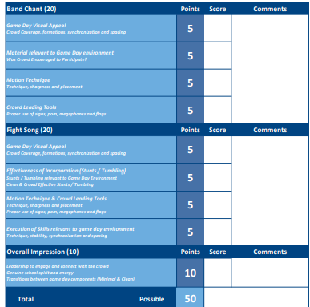
Score Sheets
Notes:
Updates coming for next season. Just use as an example- input NYSPHSAA once received- 8/16 new UCA score sheets added- MADIHA- Changes to Game Day Situation as well as Execution of stunt/tumbling instead of “skills”

Slide 13
Game Day Situation (Sideline)
Proper use of material and skills relevant to game day environment
Proper Response to Game Day situational cue
A designated game situational cue will be given for either offensive or defensive response.
The team will determine which sideline to perform, based on the cue by the announcer.
Score will be based on the quick performance and seamless transition and use of material to promote a crowd response.
Game Day Material (Cheer)
Proper use of material and skills relevant to game day environment:
The cheer should
  Be easy for the crowd to understand?
  Encourage crowd response?
  Engage the crowd right away?
  Consist of practical material.
  Only include movements and stunts used to help increase crowd participation.
Are Skills easily performed or does execution distract from ability to lead the crowd?
Notes:
Sarah

Slide 14
Crowd Effectiveness (Sideline and Cheer)
Voice:
Team voices should be LOUD & CLEAR building up to Mascots, Colors, etc.
Voices should not drop during skill incorporations
Are their voices loud and are they using proper inflection?
Pace:
Moderate pace that is easy to follow and allow the crowd time to respond
Wordy Cheers are difficult to follow
Tempo and pace of cheer consistent throughout
Flow:
Material should be seamless from beginning to end – No abrupt transitions or tempo changes
Material should be easy to understand
Maximum Crowd Coverage:
Team formation should be spread out to cover the crowd
Notes:
Sarah

Slide 15
Motion Technique / Crowd Leading Tools (Sideline and Cheer)
Motion Technique
Arm levels and proper motion placement by all team members.
How sharp are they? On the ground and in stunts.
Proper Use of Signs, Poms, Megaphones & Flags
This section is judged on how well the listed props are used to help lead the crowd in responding to the cheer.
Signs & Flags - Promote crowd involvement, easy to read, shown to crowd in time to yell
Poms - Indicate specific colors or times to yell
Megaphones - Project voices to the crowd
Important Note
Full credit will NOT be given automatically for using all
Remember - Quality vs. Quantity
Notes:
Sarah

Slide 16
Execution of Tumbling/Stunts – Proper Technique, Stability, Synchronization & Spacing (Sideline and Cheer)
Remember – Are they relevant to a true Game Day Environment? Skills should be SOLID, SAFE & should be 100% performance READY!
Proper Technique & Stability
Stunts - Top, Base and Spots
Tumbling
Keeping in mind a game day performance – all skills should be stable with no movement
Synchronization & Spacing
Timing of skills performed
Formations during all skills performed
Skills should be practical and what is practical for one team might not be practical for another.
Notes:
Sarah

Slide 17
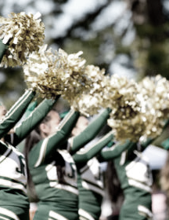
Overall Impression
Did the team “Lead the Crowd” effectively?
Did the team demonstrate “SPIRIT” raising antics?
Did the team exhibit strong “Athleticism”?
Did the team keep the crowd “Entertained”?
Was the overall routine well “Executed” which led to a “Solid” & “Safe” performance?
Notes:
Frank

Slide 18
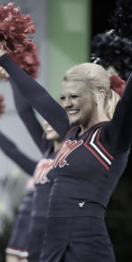
Skill Incorporations Tips
Stunts
Used to make cheerleaders visual to better lead the crowd
Stunts to consider – Preps, Extension, Liberties, Hitches
Can they still lead the crowd in the stunt?
Tumbling / Jumps
Think S-S-S – Single Synchronized Skills
Synchronized ALWAYS Better – Unless choreographed to match response
Tumbling/jump combos are better for Performance Routines
**Teams should incorporate skills that can be performed well. These skills should not inhibit their ability to lead the crowd effectively. Do what you do well and move on!
Notes:
Frank

Slide 19
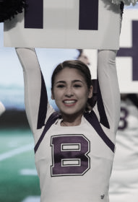
Fight Song & Band Chant Overview
Band Chant
The first section of the routine
Similar to a :30 second time out at a game
Should have an emphasis on crowd appeal and practicality
No Stunts or Tumbling permitted
Jumps and Kicks will be allowed
Fight Song
The Fight Song can incorporate Stunts and Tumbling
Should be practical and easy to follow
Must follow 8 count restrictions and additional skill restrictions
Notes:
Frank

Slide 20
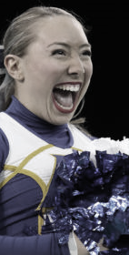
Game Day Visual Appeal
Level Changes, Ripples & Creative Movement
Use of the floor throughout the routine
Seamless flow from beginning to the end
Use of Floor and Variety of Formations
Material relevant to Game Day environment (Band Chant)
Effectiveness of Incorporation (Fight Song)
Proper use of material and skills relevant to game day environment:
Was the material practical and relevant?
Can this be performed at any time during a game and in any situation?
Was the team engaged with the crowd and encouraging participation?
Skills should be clean and effective, not a distraction.
Notes:
Frank

Slide 21
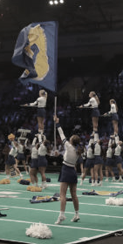
Motion Technique / Crowd Leading Tools
Motion Placement – Levels of Arms, Wrist, Elbows
Sharpness – Speed and precision, not bouncy
Synchronization – Motions and props are performed effectively as a whole or in groups
Technique – Good demonstration of team’s cheer dance ability
Timing – Staying on Counts
Spacing – Formations should be spread out for maximum crowd coverage
Props – Used effectively to encourage crowd responses
Execution
Skill Technique
Practical Skill incorporation
Proper Technique of skills performed
Stability – Strength of movement
Synchronization – Timing of skills performed
Maximum Crowd Coverage – Spread out formation to cover the crowd
Notes:
Frank

Slide 22
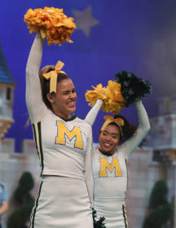
Overall Impression
Energy, Leadership & Connection to the Crowd
Energy and enthusiasm from beginning to end
Strong leadership for the crowd
Did the team keep the crowd “Entertained”?
Did the team “Lead the Crowd” effectively?
Transitions between components were smooth and effective
Notes:
Sarah

Slide 23
This concludes the Game Day Introduction Presentation
If you have any questions on this, you can contact:
Frank Ems at fems@varsity.com or mcorning@varsity.com
Notes:
Frank I have added my email as well if that is ok- MADIHA

